Slide 1
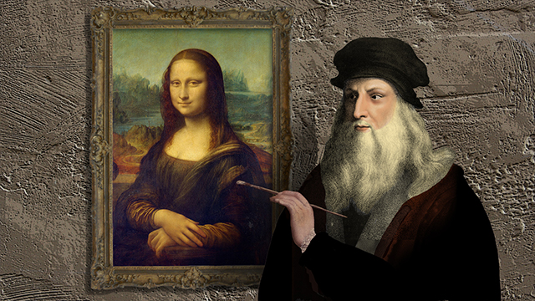
Medieval Legacies & The Renaissance

Slide 2
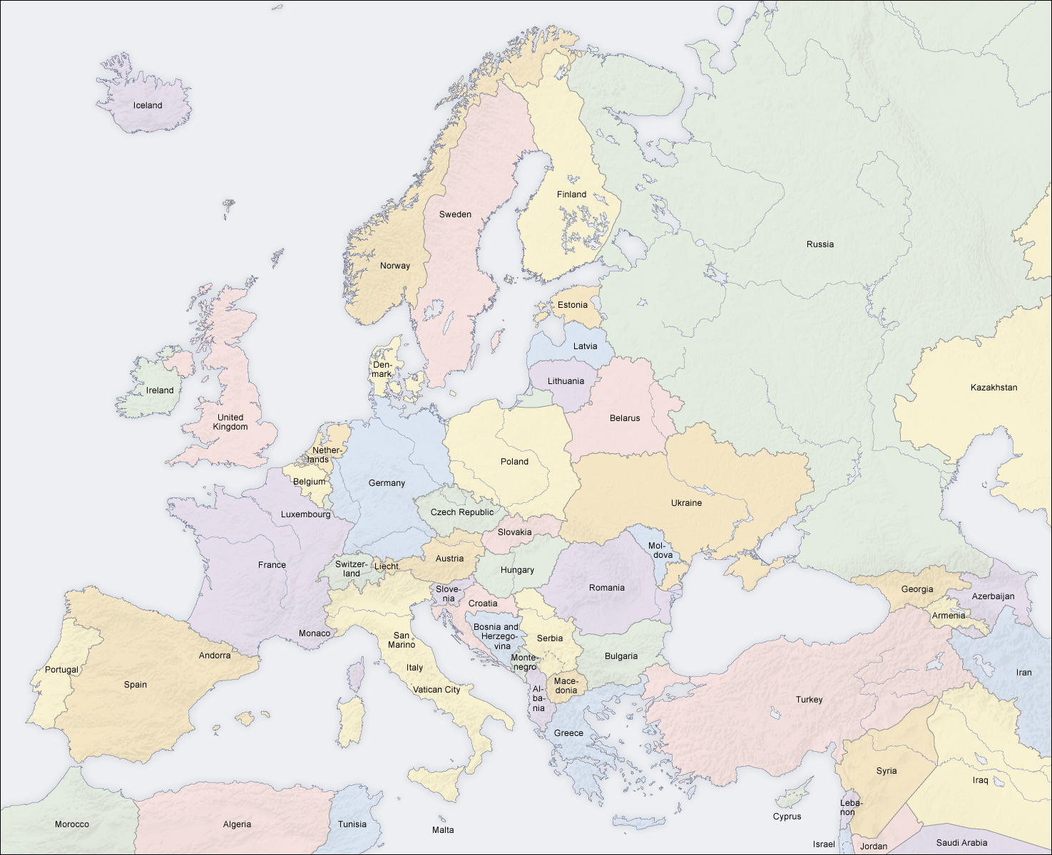
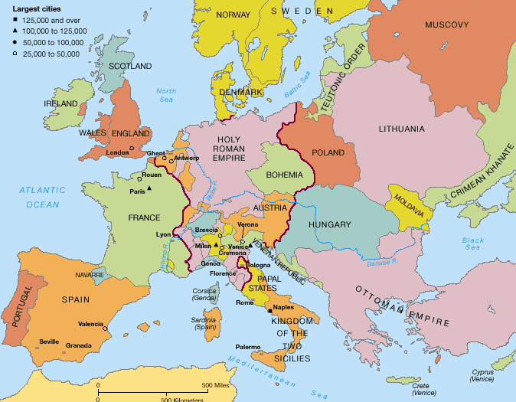

Slide 3
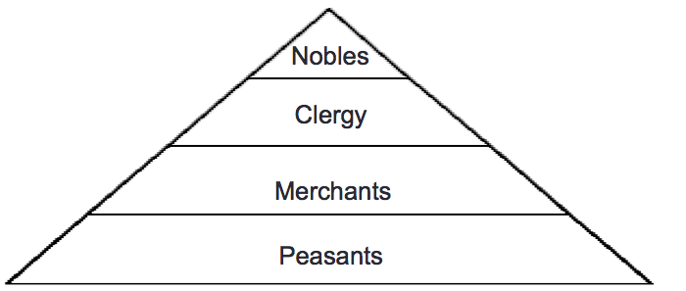
14th Century Europe
Defined by a class system: A Hierarchy of people in a society determined by economic, political, and cultural traits.
What is a hierarchy? Examples?
Economic- Money, Trade, and business
Political-Government, officials, policies, laws, right elections
Cultural- Social Values, beliefs, norms, traditions, practices
The four main groups in medieval Europe were
Nobles
Clergy
Merchants
Peasants

Slide 4
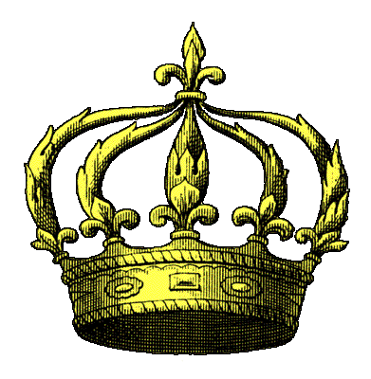
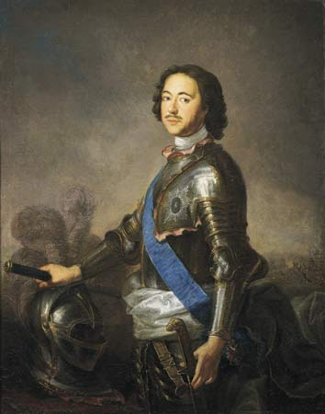
Nobles
Ran GOV/military.
Titles were hereditary.
Passed down from generations.
Had most political power
Ran large farming estates.
Had little economic power.
Upper Class (elites) w/ little education.

Slide 5
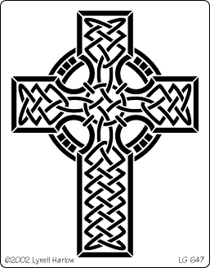
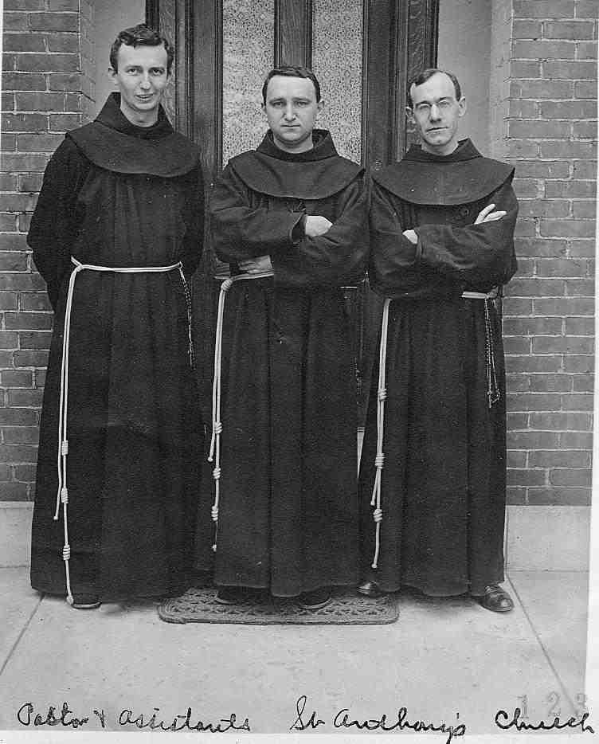
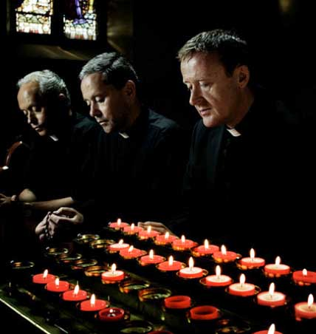
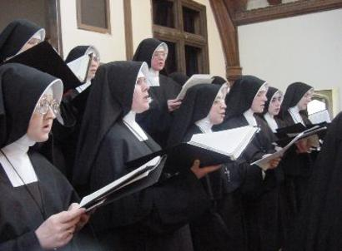
Clergy
Ran Catholic Church.
Used in GOV as advisors.
Had most spiritual power.
Ran large farming estates.
Had little economic power.
Fluid group (in all levels of society) & highly educated.

Slide 6
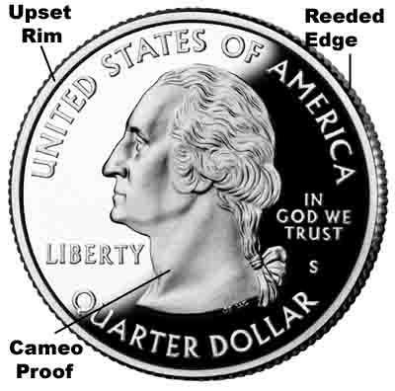
Merchants
Used in GOV as advisors.
Held little political power.
Controlled trade, banking, markets.
Had most economic power.
Middle Class (not poor, but no titles).
Highly educated & cultured.

Slide 7
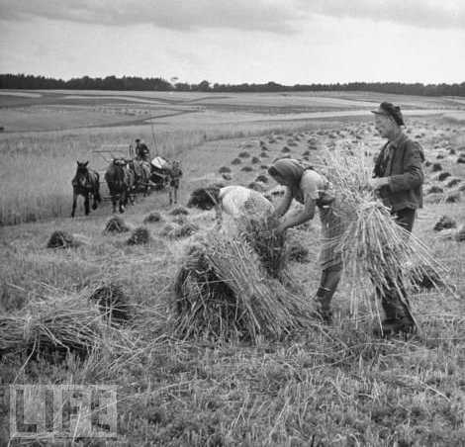
Peasants
Had no power & no rights.
Controlled by nobility & clergy.
Worked on farming estates for little or no pay.
Had most economic power.
Lower Class w/ no education.
Tied to the land & often rioted/revolted.

Slide 8
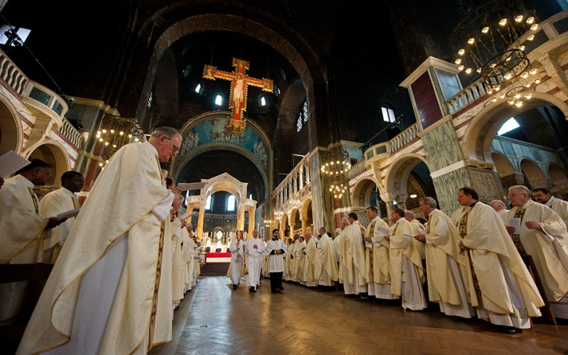
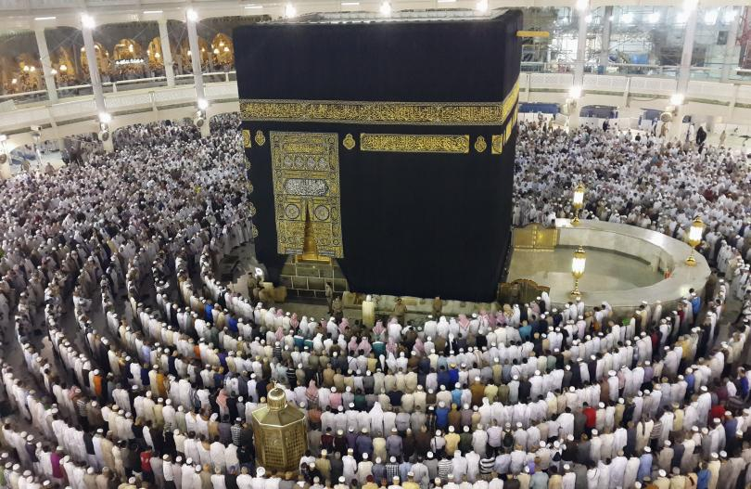
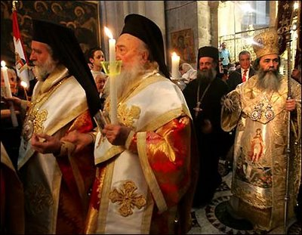
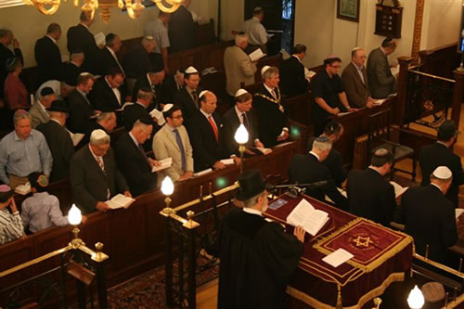
Religion of 14th Century Europe
14th Century Europe was defined by religion
What were the four main religions of 14th Century Europe?
Catholicism
Orthodoxy
Islam
Judaism
Catholicism- Western Europe & led by the Pope
Orthodoxy-E. Europe & divided by ethnic groups.
Islam-Middle East, Asia, Africa. Focus on Mohammed and the Five Pillars
Judaism-Spread to Europe. Focused on old Testament and Torah

Slide 10
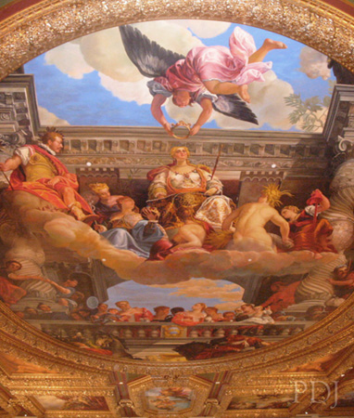
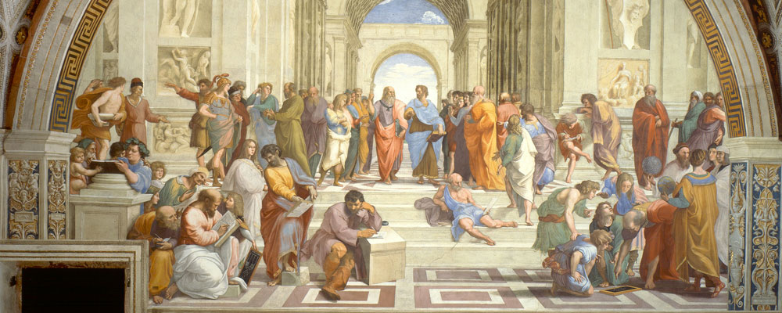
The Renaissance 1330-1530
A time of rebirth in the study of Greek and Roman Culture, art, architecture, literature, and learning
Began in Italy after the Black Death
Ended Medieval Era & began Modern era
Focused more on humanity than religion

Slide 11
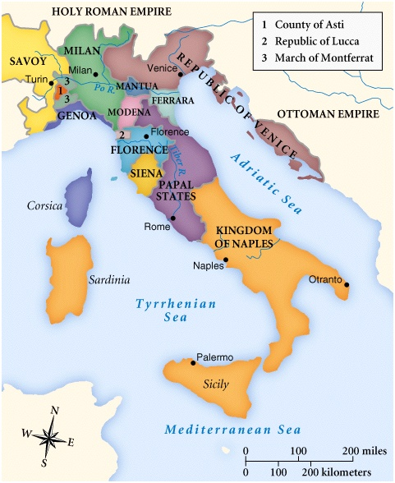
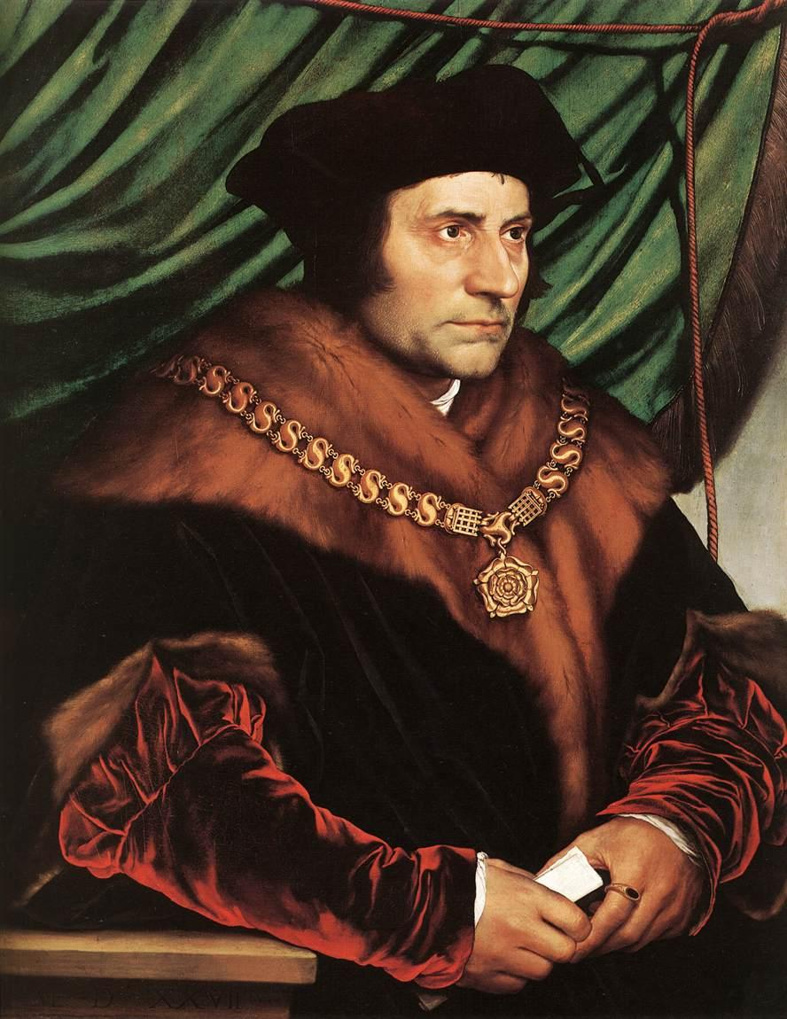
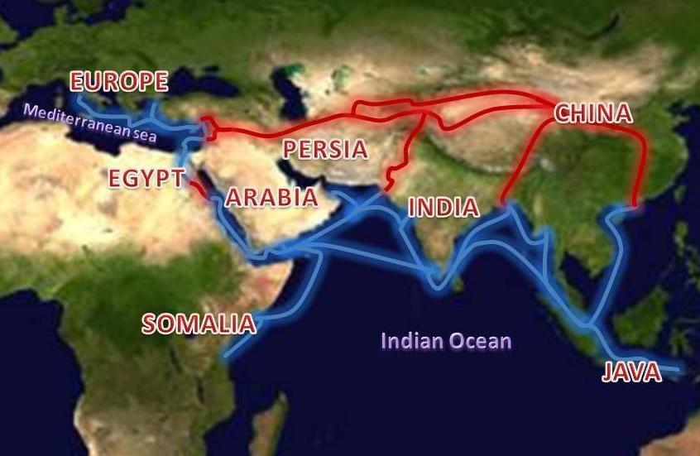
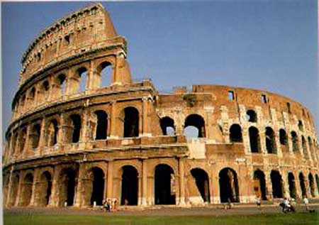
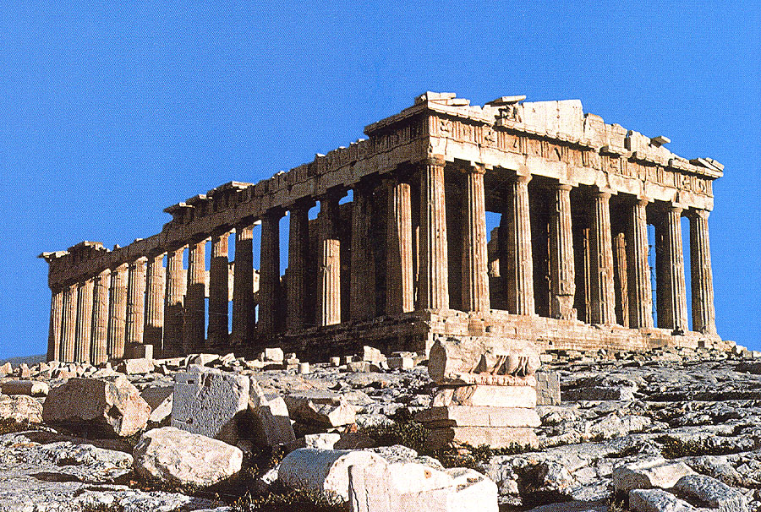
Why Italy?
Italy was divided into city-states: Independent city controlling its surrounding land
A variety of artistic thought & expression from each
A lack of common defense against outside forces
Each City-State was ran by ULTRA wealthy merchants and bankers
Focused on trade, luxurious living, and art
Money attracted artists and scholars
Merchants paid for artists work
Merchants gained their wealth from the Spice Trade: The trade of luxury goods between Europe and Asia
Spices, Silk, Perfumes
Items moved from Asia to Italy where they were stored before being sent to the rest of Europe
Why Italy?
Italians discovered Greco-Roman writings
Greek Scholars fled to Italy after the invasion of the Ottoman Empire
Greco Roman culture was something old that became cool again

Slide 12
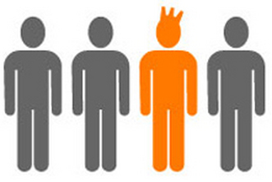
A New Way of Life
Italian Merchants and intellectuals created three new principles that defined the Renaissance and acted as guidelines in Philosophy, art, architecture, and literature
Humanism-Study and focus on human potential, glory, and understanding by modeling Classical Culture
Acted as a curriculum for educating elite sons
Study Rhetoric, arithmetic, grammar, geometry & Astronomy
Education could develop a mans limitless potential
Individualism- The study and focus on humans as individuals, developing all aspects of one’s life
Personal success over community
Once educated through Humanism a man should seek greatness
Secularism- Study of and focus on the material world more than spiritual world
Living in the here and now as well as you can
Enjoy the benefits of success
Often led to greed and corruption

Slide 13
The Renaissance (1330-1530)
Baldassare Castiglione
Niccolo Machiavelli

Slide 14
The Renaissance (1330-1530)
Baldassare Castiglione
Wrote The Courtier.
Guide to be a Civilized Man.
Taught young men how to act in all social situations.
This idea became known as a Renaissance Man.
This means to be a master of many skills.
Dancing, wrestling, music, war, arts, math, poetry, hunting, civic duty, oration.

Slide 15
The Renaissance (1330-1530)
Baldassare Castiglione
Wrote The Courtier.
Guide to be a Civilized Man.
Taught young men how to act in all social situations.
This idea became known as a Renaissance Man.
This means to be a master of many skills.
Dancing, wrestling, music, war, arts, math, poetry, hunting, civic duty, oration.
What skills does a person need to be a “Renaissance Man/Woman” today? Why?
What skills does a high school student need to be a “Renaissance Man/Woman” in GRC?
Explain who might be a Renaissance Man/Woman in your life.
What comparisons came we draw between necessary Renaissance skills & modern skills?

Slide 16
The Renaissance (1330-1530)
Niccolo Machiavelli
Wrote The Prince.
Guide to Politics & GOV.
Taught young men how to take & maintain authority in all situations.
Basic ideas…

Slide 17
The Renaissance (1330-1530)
Niccolo Machiavelli
Wrote The Prince.
Guide to Politics & GOV.
Taught young men how to take & maintain authority in all situations.
Basic ideas: GOV does not follow morality or religion, GOV is good when effective, be both a fox & a lion.
What does all this mean?

Slide 18
The Renaissance (1330-1530)
Niccolo Machiavelli
Wrote The Prince.
Guide to Politics & GOV.
Taught young men how to take & maintain authority in all situations.
Basic ideas: GOV does not follow morality or religion, GOV is good when effective, be both a fox & a lion.
What does all this mean?
Let’s answer a few questions about leadership & then Machiavelli.
In preparation for the ACT, we will now read an excerpt from The Prince & answer ten (10) questions about the passage. We will go other this in 10 minutes.

Slide 19
Please take 5 minutes to answer the questions at the bottom of the page.
Be prepared to share your answer!

